Slide 1
TEAM 8 CAPE COD TRIP JUNE 5-6, 2018

Slide 2
Day 1 Travel plans
Assemble in front of CMS no later than 6:15am for bag check. We will make one stop.
Board buses at 6:30 am
Arrive Cape Cod Sea Camps approx. 11:00 am
****Students need to bring a bag lunch****

Slide 3
Brewster, MA on Cape Cod

Slide 4
Cape Cod Sea Camps Brewster, MA

Slide 5
Cape Cod Sea Camps Waterfront
Bring Water Shoes!

Slide 6
Typical Cabin Layout
Bottom sheets and pillows are provided
Students need to bring sleeping bag/blankets, towels, washcloths, and toiletries

Slide 7
Day 1 Dinner at Sea Camps

Slide 8
Day 2 breakfast

Slide 9
Day 2 Lunch
We will be having lunch in Chatham, MA before leaving for home.
Students will need approximately $10 to purchase lunch at any of Chatham’s eateries

Slide 10
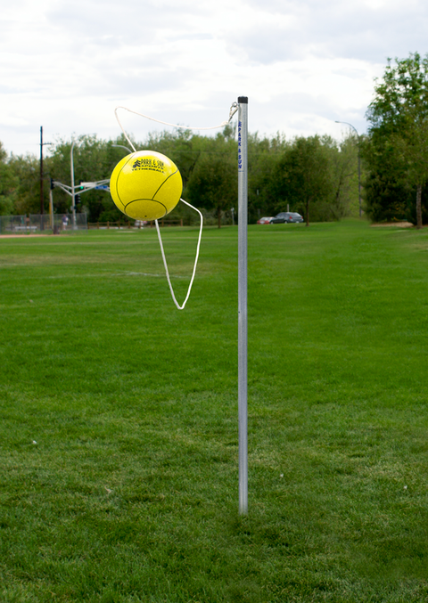
Facilities
While at the sea camps students will be able to partake in the following activities:
Soccer, basketball, tennis, volleyball, tetherball, frisbee, etc.

Slide 11
Tentative Itinerary Day 1
11:00 am: Arrive and check in/unload bags
Noon- lunch at the beach- weather dependant
1:30-buses leave for Nauset Marsh Trail for a 4 mile hike through wooded area, beach, marsh, and salt pond.
6:00 pm- Dinner
7:00 pm- Free time until movie at dusk
8:00 pm: Movie
10:00 pm: All students are in their cabin
10:30 pm Lights out/Quiet hours begin

Slide 12
Tentative Itinerary Day 2
7:00am- Rise and shine
7:30am- Breakfast
8:30am- Pack/cleaning of cabins
10:00am- Check out/board buses
10:30am- Arrive in Chatham, MA
10:30am-1:30pm- shopping and lunch
2:00pm- Depart Chatham MA for Chatham NY
6:00pm- Arrive at CMS

Slide 13
Supervision
Chaperones meet the 7:1 required ratio
Chaperones will be supervising during the night

Slide 14
Medicine Guidelines
No alcoholic beverages or illegal drugs of any type are allowed
Prescription and over the counter drugs must be given to a staff member with written instructions and permission to administer prior to departure (each bus will have a box).
All meds must be in original bottle/container
Please place med bottle in ziplock bag with written directions/permission note.

Slide 15
Guidelines
Mandatory baggage check before departure
No liquids- we will be stopping to fill water bottles or to purchase drinks on the Mass Pike (bring an empty water bottle)
Behavior expectations
Please discuss with your son/daughter appropriate behavior for this trip
Major violations will require a parent to pick up child

Slide 16
Electronic Devices
Students are encouraged to bring cell phones, however…
Students must adhere to requests adults may make to put them away/turn them off
All electronic devices will be collected by your child’s chaperone prior to bed on June 5th. These devices will be returned in the morning.

Slide 17
Packing List for the Trip
What to bring on the bus: A bag lunch, some snacks, a phone (w/charger), an empty water bottle, sweater or sweatshirt
Packing list:
Towel (one for shower and maybe one for beach)
Rain jacket (check weather forecast ahead)
Hat and sunscreen
Sleeping bag
2 changes of clothes (in case you get wet) –this includes underwear
Old sneakers or water shoes
Fleece or sweater for evening
Pajamas (or something to sleep in)
Toiletries (shampoo, deodorant, toothpaste, toothbrush, soap)
NO BATHING SUITS
Money for lunch (and shopping) on the way home.

Slide 18
Other…
Students filled out food allergy/dietary requests form
Students will be provided with a checklist of items to bring (clothing based on weather forecast, sleeping bag, snacks, etc…)
This presentation as well as the checklist of items to bring will be posted on Mr. L’s website and Google Classroom.
Questions?

