Slide 1
Age of Immigration
1850-1920

Slide 2
What is Immigration?
The action of coming to live permanently in a foreign country.

Slide 3
How did Immigrants come to the United States?
Immigrants would come by boat from either Europe or Asia
Immigrants would crowd onto ships where there was not enough food or resources for them to survive.
This led to the immigrants dying from starvation or by disease.
Since the immigrants lived in such tight quarters, disease would spread quickly across the ship.

Slide 4
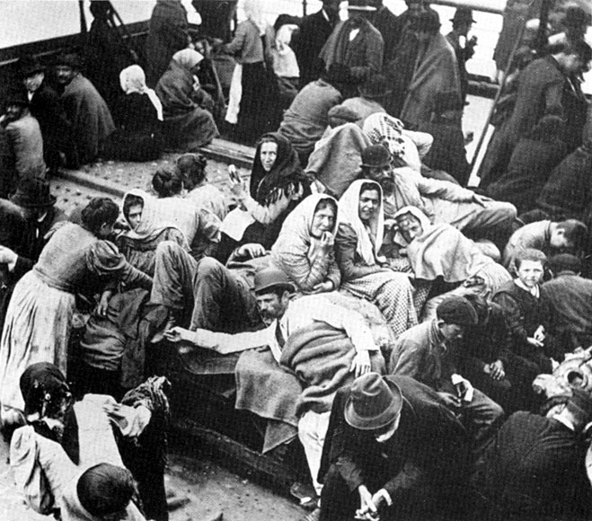

Slide 5
Push Factors
Conditions in your homeland that cause you to want to leave and come to America.
Famine, lack of jobs, lack of freedom, political or religious persecution

Slide 6
Pull Factors
Conditions in America that attract you to this country.
Jobs, freedom, land, hope for a better life

