Slide 1
Age of Immigration
1850-1920

Slide 2
“Old” Immigrants
Came from Northern/western Europe
England, Ireland, Scotland
Between 1840-1880
Mainly Protestant
Most spoke English
Mostly Farmers
Came in smaller numbers

Slide 3
“New” Immigrants
Came from Southern and Eastern Europe
Italy, Greece, Russia, Poland, etc…
Between 1880 and 1920
Various Religions (Judaism, Catholicism, Eastern Orthodox
Spoke various languages (Greek, Italian, Russian)
Mainly became factory workers
Came in larger numbers

Slide 4
Assimilation
The process of becoming part of another culture.
“Old” Immigrants assimilated very well into American Society.
“New” Immigrants had a harder time assimilating.

Slide 5
Ethnic Neighborhoods Created
Most set up in major cities
Immigrants live within ethnic “enclaves”
Offers familiarity, comfort
Benefits of old and new life
Little Italy, China Town, etc…
Tenement Life

Slide 6
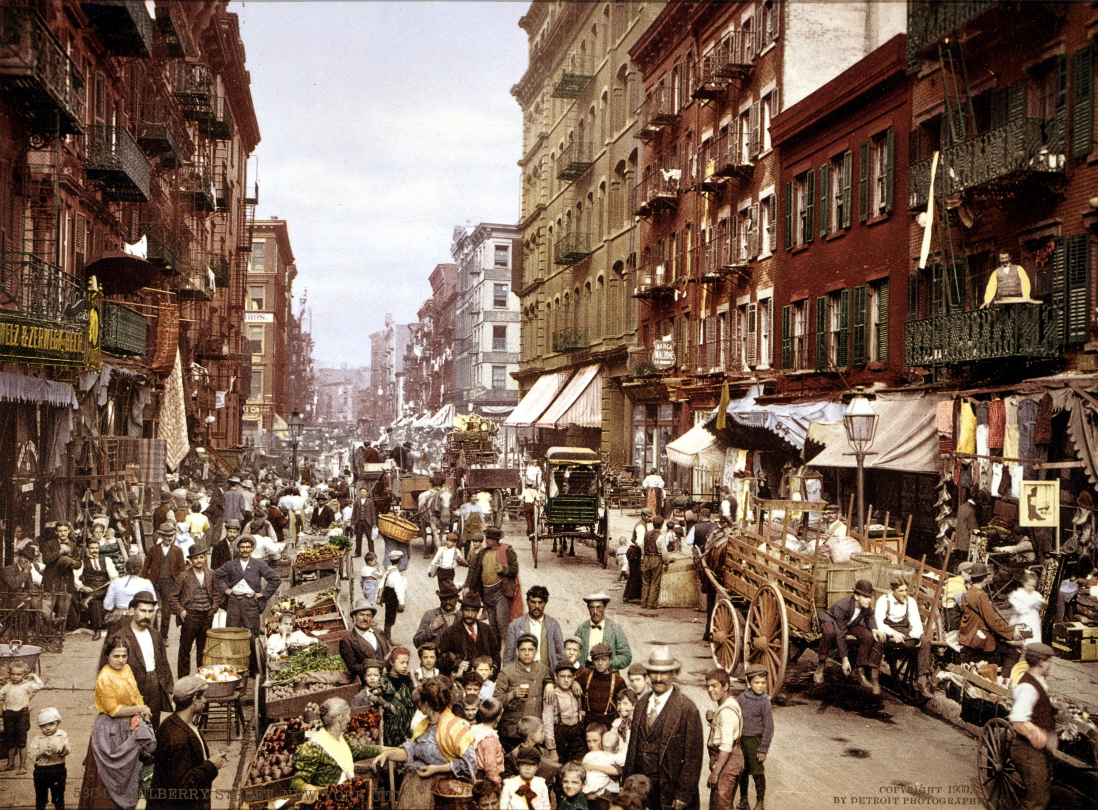

Slide 7
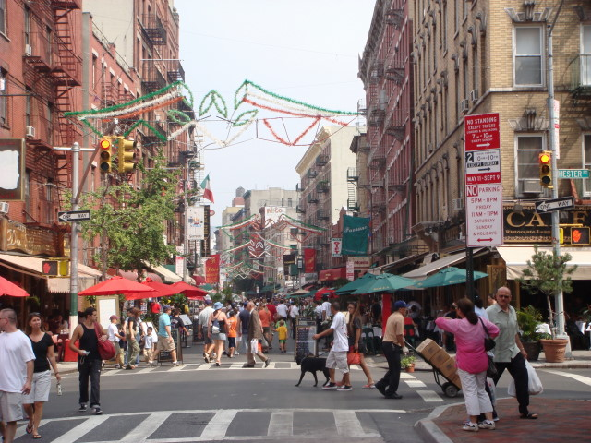

Slide 8
Tenement
A run-down and often overcrowded apartment house, especially in a poor section of a large city.

Slide 9
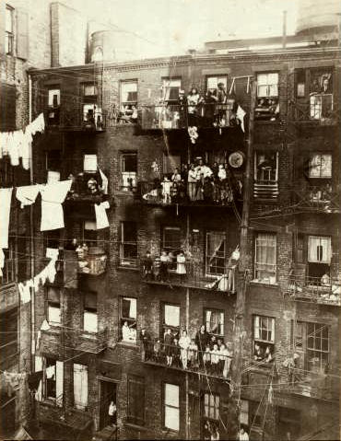

Slide 10
