Slide 1
WELCOME TO 8TH GRADE
2017 - 2018

Slide 2
Team 8 Expectations/Procedures
Students should be using planners upon entering each class (to keep track of assignments, projects, and upcoming tests and quizzes)
Students need to come prepared for each class with all materials (binder, notebook, pen/pencil, homework, chromebook, etc.)
Active participation in all class or group activities

Slide 3
8th Grade Goals
Common Core
Building skills for success in high school and beyond
Responsibility
Initiative
7th grade
8th grade
9th grade

Slide 4
Parent Portal
Gradebooks will be updated at least every two weeks
Grading policies are located on teacher websites
All assignments will be clearly labeled
Contact us with any questions
Students will be given instruction and access to the parent portal and it’s expected that they will check their grades and be on top of the assignments they owe.

Slide 5
Special Education/Academic Support Mrs. West and Mrs. Fuss
Support students in and out of the general education classrooms
Assist students with re-teaching of material, as well as homework and class work
Available during lunch and after school (Tuesday-Friday)

Slide 6
Services
Responsibilities
Inclusion Model/ Co – teaching
Collaboratively plan lessons and teach with regular ed teachers
Resource Room
Work on specific goals identified for each student
Academic Intervention Services
Provide remedial services in math and ELA
Oversee the implementation of each IEP
Provide program modifications
Provide testing modifications
Collaborate with teaching assistants, aides, general education teachers, special area teachers and parents

Slide 7
Math Flipped Classroom
Emphasis is on collaborating and showing work
Advantages:
Students can choose to work ahead
Class time becomes a student learning environment
Teacher becomes a facilitator of learning
Classroom Procedure
Warm Up
Review of notes and questions addressed
Students collaborate to work on problems
More student activities

Slide 8
Math/ Algebra
Mrs. Keller
Grade 8 Math
All math eight students must take a midterm and a final
NYS Math 8 exam is given May 1-3
Algebra 1 Common Core
Midterm is given in January
Regents exam is given in June at the HS
Final average consists of 4 quarters and regents/midterm

Slide 9
Physical Science/ Earth Science
Mr. Kahn
Physical Science covers every aspect of science except biology.
Regents Earth Science covers astronomy, meteorology, mineralogy, petrology, geomorphology, vulcanology, seismology, oceanography and paleontology .
Extra help is available during lunch, before and after school.

Slide 10
Physical Science/ Earth Science
Mr. Kahn
All Physical Science students take this exam
There are two parts of the NY State I.L. Science Test, a lab exam and a 2 hour written exam. They are usually given at the end of May or beginning of June.
NY State Earth Science Regents has two parts as well, a lab exam and a 3 hour written exam. The exam is usually given mid June. E.S. students take only the E. S. Regents exam.

Slide 11
Social Studies
Mr. Laudenschlager
History of the United States and New York
Reconstruction - 9/11
Historical Thinking/Reading strategies
Current Events
Class participation is huge in my class!
My Website
Focus: How human interaction and movement shaped modern America.

Slide 12
ELA
Ms. Hetterich
Independent Reading: Library approach to reading- students choose their own books and should be reading at least ½ hour a night, five days a week.
Any graded writing assignment may be revised for a higher grade if revisions are turned in within two weeks.
Text used in class: Holt McDougal Literature
Vocabulary books – tests are on Fridays
Pre-AP Requirements

Slide 13
Spanish
Mrs. Powell
Focus on culture and communication
Strengthen vocabulary, grammar skills, and overall comprehension
Students must pass the class and pass the final exam in order to receive high school credit for level 1 language (required to graduate High School)
Grades in 8th grade Spanish will appear on the High School report card/transcript
Extra help available after school

Slide 14
High School Credit
The following courses earn high school credit and all grades will appear on the high school transcript:
Algebra
Earth Science
Spanish
Grading:
Quarter 1 20%
Quarter 2 20%
Midterm 5%
Quarter 3 20%
Quarter 4 20%
Regents 15%
or Final
Notes:
8th Grade class trip to Cape Cod
Fundraiser will be from Nov 9 through Dec 1st. Delivery date is the week before Christmas. It’s a new company for us- Eco Friendly Candles- and delivery date is the week before Christmas.

Slide 15
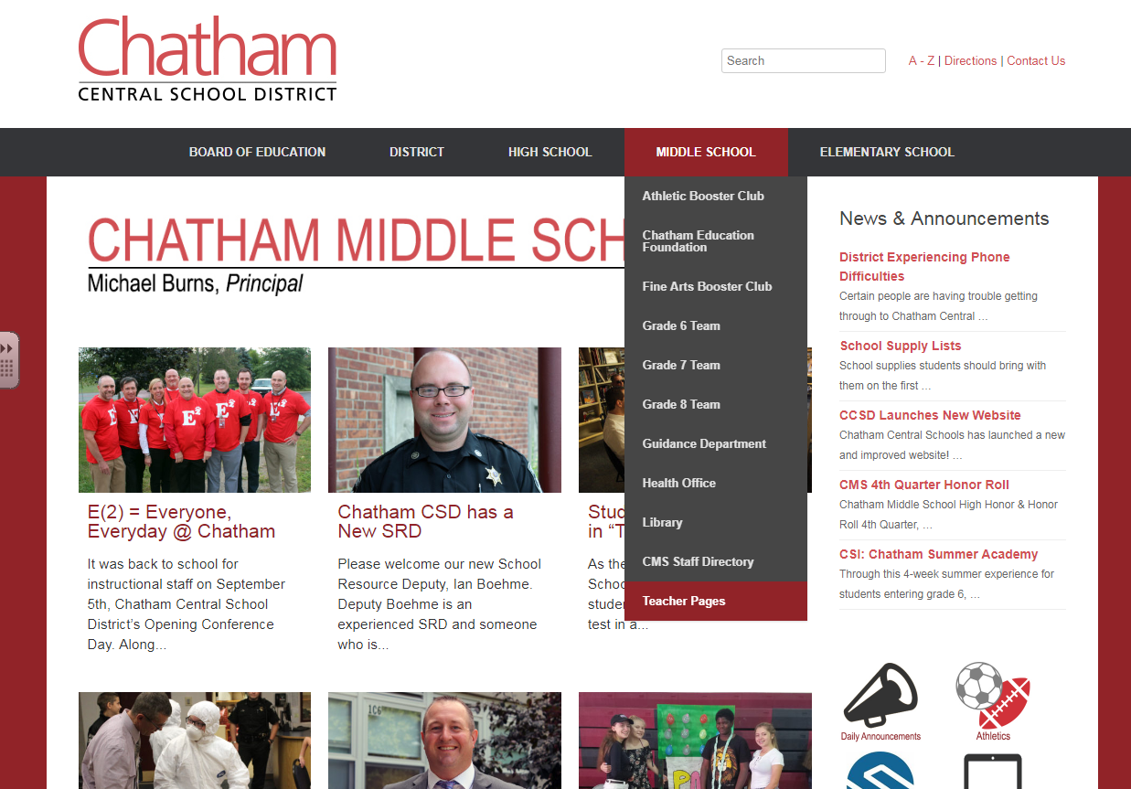
PLEASE VISIT TEACHER PAGES FOR MORE INFORMATION

